Slide 1
Machine Learning-Based Predictive Analytics for Supply Chain Optimization
REVIEW – III | Batch 15 — Team 15 | Guide: Dr. K. Swapnika
Department of CSE, KLH University, Bachupally | A.Y. 2026–2027

Slide 2
Review-III at a Glance
• 2,096,319 records cleaned and integrated across 3 public benchmark datasets
• 500 store–item series, 913,000 daily observations, 57 engineered features
• Full pipeline implemented: ingest → EDA → features → forecasting → risk → optimisation → XAI → dashboard
• Best ML model MAPE 12.11 % vs SARIMA 19.19 % on identical test rows
• MAPE reduction vs statistical baseline: 36.9 % lower error
• Inventory: total cost down 2.1 % at matched service; stock-outs down 25 % under a lead-time disruption
• Delay risk: F1 0.722 (target 0.85 not met - documented); lead-time sigma_L = 1.27 days measured on DataCo

Slide 3
Architecture as Implemented
• Tier 1 Data: src/fetch_data.py + src/data_ingest.py (D1 DataCo, D2 Store-Item Demand, D3 Online Retail II)
• Tier 2 Processing: src/features.py — 57 model features + 28-day LSTM sequence
• Tier 3 Intelligence: SARIMA, Random Forest, XGBoost, LightGBM, LSTM, weighted ensemble; delay-risk classifier; lead-time regression
• Tier 4 Prescription: safety stock / ROP / EOQ engine, SHAP explainability, Streamlit dashboard
• Orchestrated by src/run_pipeline.py with fixed seeds — fully reproducible

Slide 4
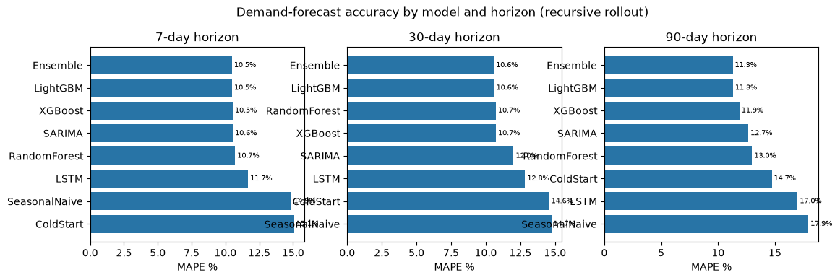
Multi-Horizon Demand Forecasting — Results
• Recursive 184-day rollout; each model feeds back its own predictions
• Matched-subset test: identical SKUs and dates for every model
• Best ML model: MAPE 12.11 %, MAE 6.46, R² 0.928
• SARIMA baseline: MAPE 19.19 %
• LSTM: one-step MAPE 11.74 % with 17,861 parameters
• Lag-feature ablation: 32.8 % error reduction vs calendar-only

Slide 5
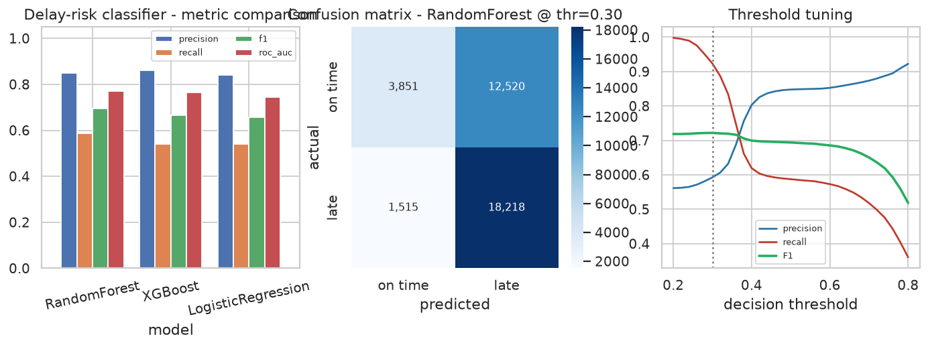
Delay-Risk & Lead-Time Prediction
• Temporal hold-out: 36,104 unseen orders, 275 features after encoding
• Best classifier RandomForest: F1 0.722, ROC-AUC 0.769
• Lead-time model MAE 0.96 days
• Measured σ(lead time) = 1.27 days feeds the safety-stock formula
• Leakage-controlled: post-delivery fields excluded from the feature set

Slide 6
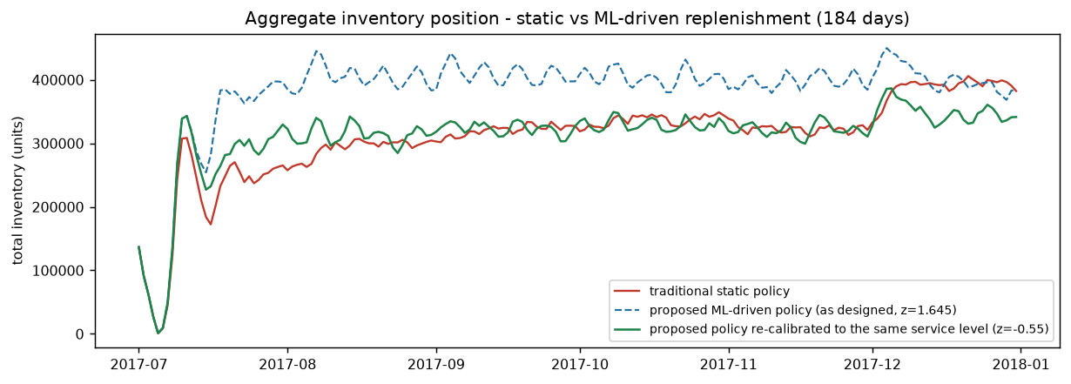
Forecast-to-Prescription Inventory Optimisation
• Controlled study: both policies face identical demand and identical lead-time draws
• E1 - forecast alone (same formula both sides): total cost down 3.07 %, stock-outs down 3.50 %
• E2 - as-designed risk-aware policy vs traditional practice: total cost down 2.12 % at matched service
• E3 - LEAD-TIME DISRUPTION (3x variability): fill rate 95.14 % -> 96.36 %, stock-outs down 25.0 %, total cost down 13.5 %
• HONEST NEGATIVE RESULT: the 15-20 % holding-cost target is NOT met (holding cost up 0.59 % at matched service) - a better forecast buys resilience, not cycle-stock savings

Slide 7
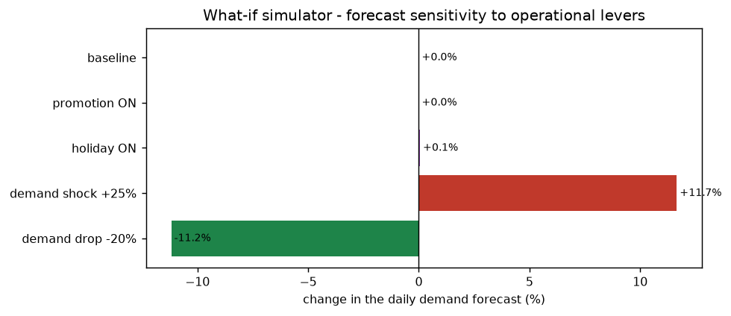
Explainable AI and Decision Support
• SHAP beeswarm and dependence plots for the forecasting model
• Global and local attribution for the delay-risk classifier
• What-if simulator quantifies promotion, holiday and demand-shock scenarios
• Live order risk calculator inside the dashboard uses the trained classifier
• Designed so a planner can see, trust and override the recommendation

Slide 8
Objectives vs. Achieved Results
• O1 forecasting: MAPE 12.11 % and 36.9 % better than SARIMA - target >=25 % ACHIEVED
• O2 inventory: total cost down 2.12 % at matched service, stock-outs down 25 % under disruption - PARTIALLY ACHIEVED (holding-cost target not met, documented)
• O3 risk: F1 0.722 - target 0.85, PARTIALLY ACHIEVED (cause diagnosed)
• O4 dashboard: 5-tab Streamlit app with a live risk calculator - ACHIEVED
• O5 benchmarking: 3 datasets, temporal hold-out, ablation, matched subset, service-matched policy study - ACHIEVED
• O6 reproducibility: one-command pipeline with fixed seeds and auto-generated report - ACHIEVED

Slide 9
Next Phase
• Temporal Fusion Transformer (pytorch-forecasting) added to the ensemble with attention-based interpretation
• Supplier-level history and cost-sensitive learning to lift delay-risk F1 to ≥ 0.85
• Per-SKU-family cost calibration and stochastic lead-time distributions
• Dockerfile + FastAPI endpoints (/forecast, /recommend, /explain) and role-based dashboard views
• Diebold–Mariano significance testing, rolling-origin evaluation, drift monitoring
• Conference paper draft and end-to-end demonstration video

Slide 10
Thank You
• Questions and demonstration
• Repository: github.com/shivasaivinesh/KLH-CSE-2026-27-2420030691-supply-chain-optimization-
• Run everything with: python src/run_pipeline.py

